Slide 1
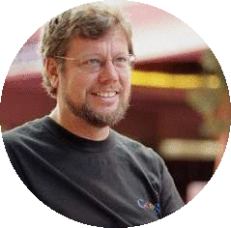
Python History
Python programming language was conceived by Guido van Rossum.
Guido van Rossum started python implementation at Centrum Wiskunde & Informatica (CWI) in the Netherlands in December 1989 and released 1st version in Feb. 1991.
He was named after the BBC TV show Monty‘s Python Flying Circus in late 1980’s

Slide 2
Python Features
1) Easy to Learn and Use
Python is easy to learn and use. It is developer-friendly and high level programming language.
2) Expressive Language
Python language is more expressive means that it is more understandable and readable.
3) Interpreted Language
Python is an interpreted language i.e. interpreter executes the code line by line at a time. This makes debugging easy and thus suitable for beginners.
4) Cross-platform Language
Python can run equally on different platforms such as Windows, Linux, Unix and Macintosh etc. So, we can say that Python is a portable language.
5) Free and Open Source
Python language is freely available at official web address. The source-code is also available. Therefore it is open source.

Slide 3
6) Object-Oriented programming Language
Python supports object oriented language concepts of classes and objects come into existence.
7) Extensible & Integrated
It implies that other languages such as C/C++ can be used to compile the code and thus it can be used further in our python code.
8) Large Standard Library
Python has a large and broad library and provides rich set of module and functions for rapid application development.
9) GUI Programming Support
Graphical user interfaces / windows based apps can be developed .
10) Garbage collection
I python gc() automatically garbage collects after utilization of the memory
11) Python is Portable(architecture neutral):
Python is portable language . i.e python code run on platform such as windows, Linux, Unix and Mac then we do not need to change it.
12) Dynamically Typed:
Python is dynamically-typed language. i.e for a variable is decided at run time not in advance. because of this feature we don’t need to specify the type of variable.

Slide 4
core python
History of python
Applications
Users
features
Keywords
Operators
i/o statements
Flow control
Strings
List /tuple / dictionary / sets
Functions
Modules
Packages
File handling
advanced python
OOPS
Exception handling
Multi threading
Regular expressions
Gui using tkinter
Pdbc using my/sql
Towards Data science pkgs
1.numpy matplotlib openpyxl

Slide 5
Applications of Python
Desktop applications
Web applications with Django
Database applications
Network applications
Games
Data analysis/ science
Machine learning / deep learning
Artificial intelligence
iot

Slide 6
Python Users
Google
Facebook
Youtube
Dropbox
Pintrest
BBC
NASA
AT&T
New York Times
Netfilx

Slide 7
Python Supports Different paradigms
Scripting from ‘shell / perl’
Syntax from ‘C & ABC ‘
Functional programming from ‘C’
Modules from modula-3
OOPs from C++

Slide 8
Python Environment
1.Interactive Mode
2.Script Mode
3.IDLE /shell
Popular IDE’s of Python
1. PyCharm
2. Jupyter notebook
3. VS Code
4. Spyder etc..

Slide 9
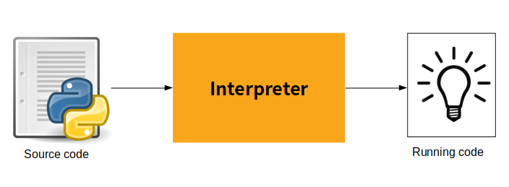
Python Code-execution

Slide 10
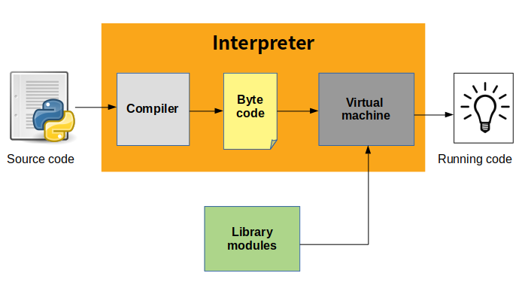
Inside Interpreter
Python Virtual Machine(PVM)

Slide 11
Python Data Types
Immutable
mutable
Numbers
Strings
Tuples
List
Dictionaries
Sets
int
float
complex
string
multi line string
int
float
string
int
float
complex
String
int
float
complex
String
int
float
complex
String
Boolean : True / False

Slide 12
Python Keywords
true | false | None | and | as
assert | def | class | continue | break
else | finally | elif | del | except
global | for | if | from | import
raise | try | or | return | pass
nonlocal | in | not | is | lambda
 |  | while | with | yield

Slide 13
input / output
*. input() : used to read the data from the user at run-time
*. print(): used to display the data/ message/ values on the screen
( IDLE )
Variable: a name given to a memory location to store the values temporarily
* declaration
* assignment

Slide 14
Python Types of operators
*. arithmetic
*. relational
*. assignment
*. logical
*. membership
*. identity
*. bitwise

Slide 15
Arithmetic Operators
Operators | Description
// | Perform Floor division(gives integer value after division)
+ | To perform addition
- | To perform subtraction
* | To perform multiplication
/ | To perform division
% | To return remainder after division(Modulus)
** | Perform exponent(raise to power)

Slide 16
Comparison Operators
Operator | Description
< | Less than
> | Greater than
<= | Less than or equal to
>= | Greater than or equal to
== | Equal to
!= | Not equal to

Slide 17
Assignment Operators
Operator | Description
= | Assignment
/= | Divide and Assign
+= | Add and assign
-= | Subtract and Assign
*= | Multiply and assign
%= | Modulus and assign
**= | Exponent and assign
//= | Floor division and assign

Slide 18
Logical Operators
Operator | Description
and | Logical AND(When both conditions are true output will be true)
or | Logical OR (If any one condition is true output will be true)
not | Logical NOT(Compliment the condition i.e., reverse)

Slide 19
Identity Operators
Operator | Description
is | Returns true if identity of two operands are same, else false
is not | Returns true if identity of two operands are not same, else false.

Slide 20
Membership Operators
Operator | Description
in | Returns true if a variable is in sequence of another variable, else false.
not in | Returns true if a variable is not in sequence of another variable, else false.

Slide 21
Bitwise Operators
& and
| or
^ carat

